Slide 1

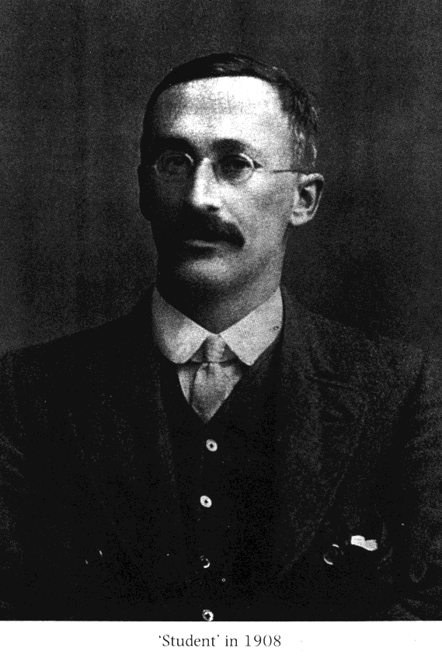

GOSSET, William Sealy 1876-1937

Slide 2
The t-distribution is a family of distributions varying by degrees of freedom (d.f., where
d.f.=n-1). At d.f. = ∞, but at smaller than that, the tails are fatter.

Slide 3
_
X - μ
z =
-
σ_{X}
_
X - μ
t =
-
s_{X}
s
-
s_{X} =
√ N

Slide 4
The t-distribution is a family of distributions varying by degrees of freedom (d.f., where
d.f.=n-1). At d.f. = ∞, but at smaller than that, the tails are fatter.

Slide 5
Degrees of Freedom
df = N - 1

Slide 6
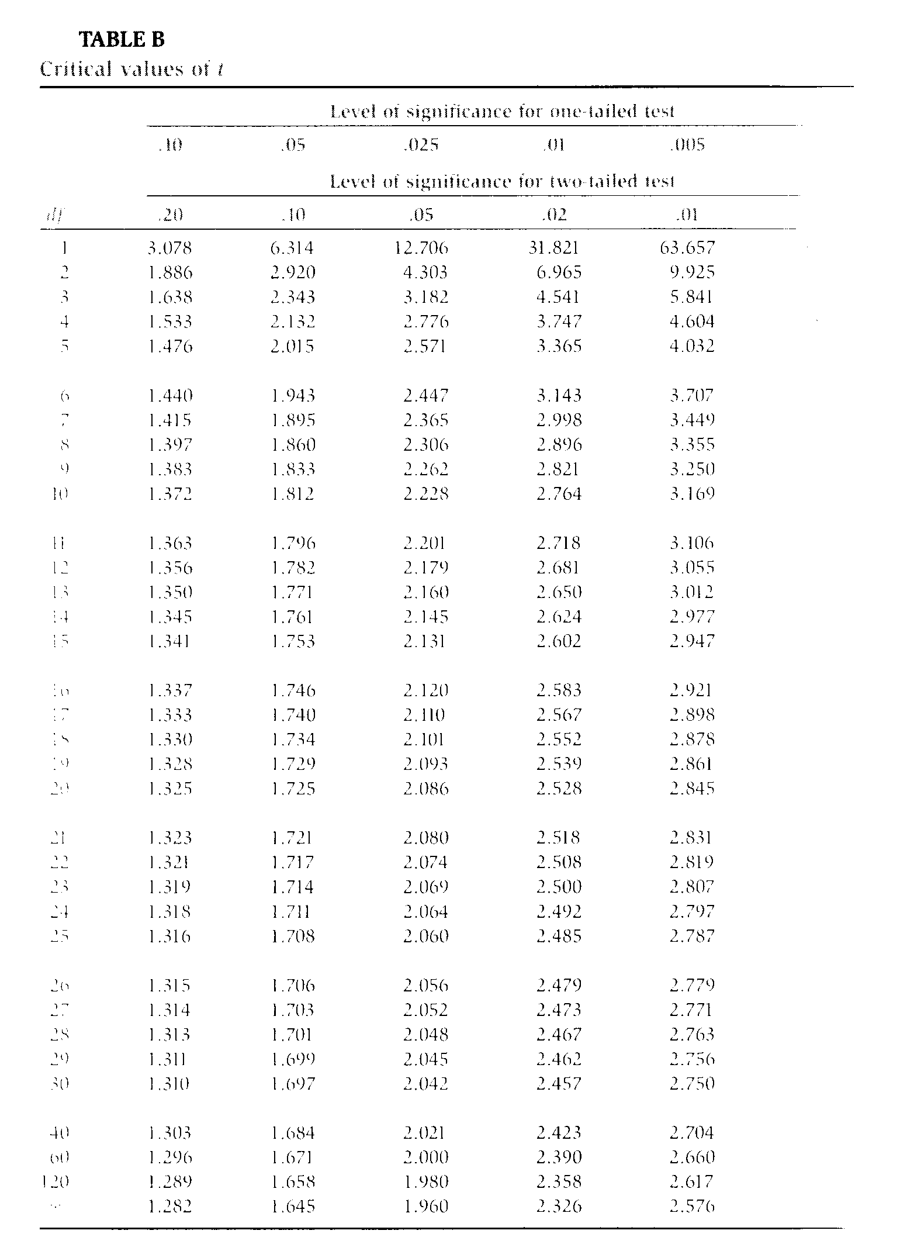

Slide 7
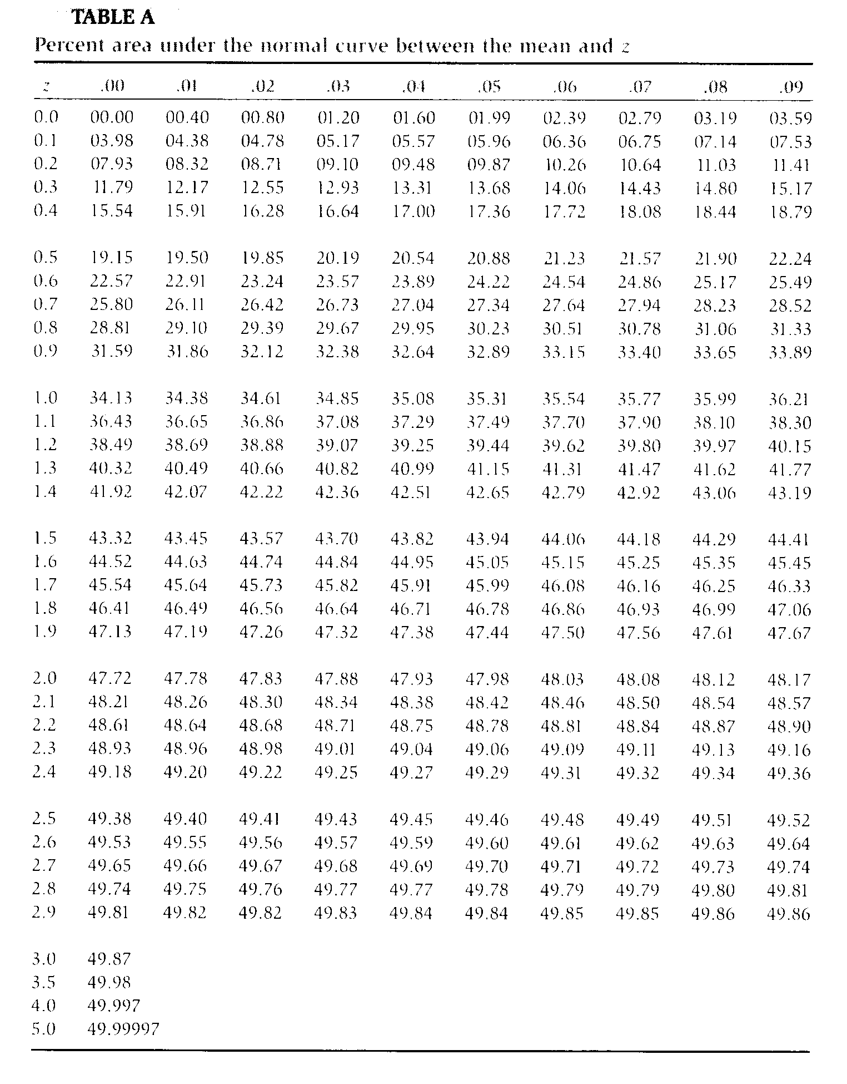

Slide 8
Problem
Sample:
Mean = 54.2
SD = 2.4
N = 16
Do you think that this sample could have been drawn from a population with μ = 50?

Slide 9
Problem
Sample:
Mean = 54.2
SD = 2.4
N = 16
Do you think that this sample could have been drawn from a population with μ = 50?
_
X - μ
t =
-
s_{X}

Slide 10
The mean for the sample of 54.2 (sd = 2.4) was significantly different from a hypothesized population mean of 50, t(15) = 7.0, p < .001.

Slide 11
The mean for the sample of 54.2 (sd = 2.4) was significantly reliably different from a hypothesized population mean of 50, t(15) = 7.0, p < .001.

Slide 12
Sample_{C}
Sample_{D}
r_{XY}
r_{XY}
Population
Sample_{B}
ρ_{XY}
r_{XY}
Sample_{E}
Sample_{A}
_
r_{XY}
r_{XY}

Slide 13
The t distribution, at N-2 degrees of freedom, can be used to test the probability that the statistic r was drawn from a population with ρ = 0. Table C.
H₀ : ρ _{XY} = 0
H₁ : ρ _{XY} ≠ 0
where
r N - 2
t =
1 - r²

